Slide 1


Document Overload at Kochi Metro Rail Limited
Smart India Hackathon 2025Problem Statement ID: SIH25080 | Team CodeNirbhar | Software Automation

Slide 2




The Critical Challenge
Document Overload
Processing Delays
High volume and diversity of documents across technical, HR, legal, and financial departments
Manual scanning creates bottlenecks, slowing critical decision-making processes
Siloed Operations
Compliance Risks
Departments work independently, leading to poor coordination and communication gaps
Lost institutional knowledge and regulatory compliance failures due to inefficient processes

Slide 3





Current Workflow Crisis
Multiple Inputs
Documents flood in from various sources
Manual Processing
Staff manually review each document
Departmental Summaries
Individual departments create isolated reports
Critical Delays
Bottlenecks cause missed deadlines and compliance failures

Slide 4
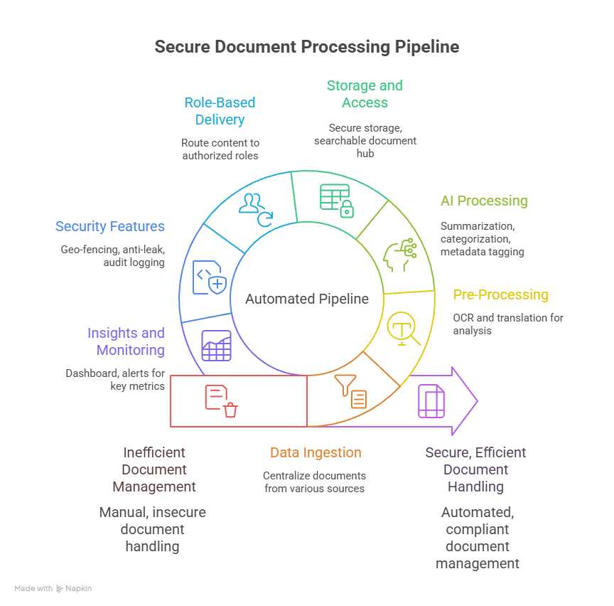

Slide 5

Our Automated Document Hub Solution
Core Capabilities
Smart Features
Role-based authentication with super-admin control
Intelligent categorization and metadata tagging
Centralized hub integrating emails, WhatsApp, cloud storage
Automated alerts and routing systems
Secure watermarking and traceability
Advanced OCR for English and Malayalam documents
Comprehensive analytics dashboard
AI-powered bilingual summarization

Slide 6

Enterprise-Grade Security
Dynamic Watermarking
Both visible and invisible watermarks ensure document authenticity and prevent unauthorized distribution
User Traceability
Complete audit trail allows backtracking of any document leaks or unauthorized access attempts
Role-Split Approvals
Distributed administrative power prevents single points of failure and reduces corruption risks
Controlled Access
Ephemeral access controls and selective redaction with comprehensive audit logging

Slide 7
Measurable Impact Analysis
Feature
Impact
AI Summarization
70% faster decision-making process
Auto Categorization
60% reduction in document search time
Alerts & Routing
90% improvement in compliance adherence
Knowledge Hub
100% retention of institutional knowledge
Central Hub
40% reduction in work duplication
These metrics demonstrate quantifiable improvements across all operational areas.

Slide 8





What Makes Us Unique
Metro-Specific Design
First system specifically engineered for metro and urban transport sector requirements, understanding unique operational challenges
Bilingual AI Processing
Advanced AI summarization supporting both English and Malayalam, crucial for local government operations
Forensic Watermarking
Geo-fenced and forensic watermarking technology prevents document leaks and ensures complete traceability
Security
Designed with a scalable cloud-native architecture and enterprise-grade security like RBAC, geo-fencing, watermarking, and encryption to ensure reliability and data protection.

Slide 9
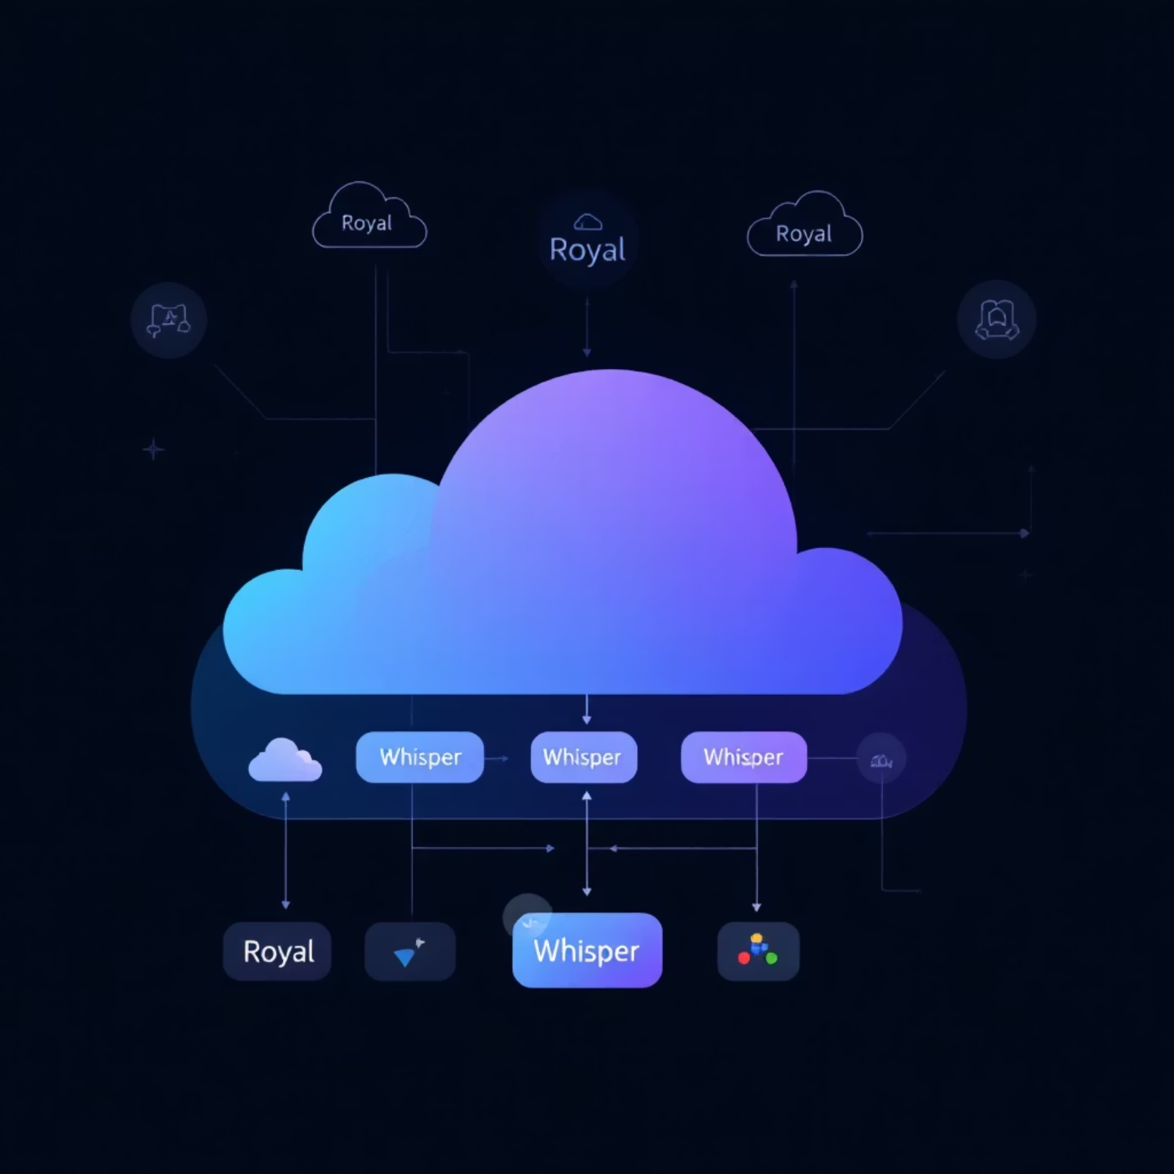
Robust Technology Architecture
Backend Infrastructure
Runtime: Node.js with Express frameworkDatabase: MongoDB for scalable document storage
Frontend & Automation
Interface: React with TailwindCSSWorkflow: N8N for intelligent automation
Cloud & AI Services
Platform: AWS (S3, Lambda, EC2)AI/NLP: OCR with Tesseract, Google Vision API, HuggingFace Transformers

Slide 10

Transformational Impact at KMRL
40%
200+
30%
90%
Faster Processing
Hours Saved
Cost Reduction
Compliance Rate
Accelerated handling of 10,000+ daily documents
Man-hours recovered per week for strategic work
Annual savings through efficiency and error elimination
Regulatory adherence improvement

Slide 11

Transform Document Chaos into Smart Knowledge
From Overload to Hub
Complete Solution
Triple Impact
KMRL transitions from document chaos to intelligent knowledge management
Secure, automated, scalable, and bilingual document processing
Enhanced efficiency, regulatory compliance, and enterprise security
Team CodeNirbharReady to revolutionize document management at KMRLSmart India Hackathon 2025

